Slide 1
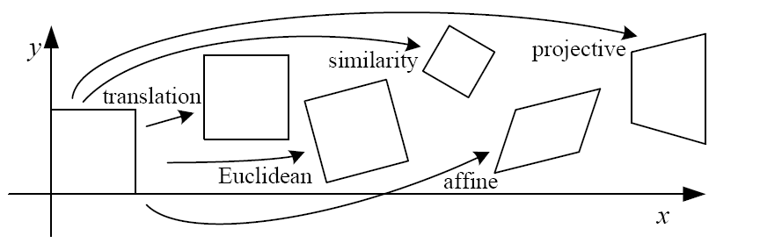
Geometric transformation

Slide 2
References
http://szeliski.org/Book/
http://www.cs.cornell.edu/courses/cs5670/2019sp/lectures/lectures.html
http://www.cs.cmu.edu/~16385/

Slide 3
contents
2D->2D transformations
3D->3D transformations
3D->2D transformations (3D projections)
Perspective projection
Orthographic projection

Slide 4
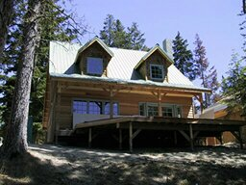
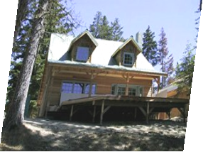
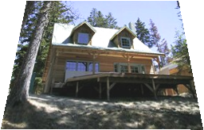
objective
Being able to do all of the below transformations with matrix manipulation:
Why matrix manipulation?
translation
rotation
scale
shear
affine
projective

Slide 5
objective
Being able to do all of the below transformations with matrix manipulation:
Why matrix manipulation? Because then we can easily concatenate transformations (for example translation and rotation).
translation
rotation
scale
shear
affine
projective

Slide 6
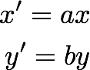

2D planar transformations

Slide 7
scale
How?
Scale

Slide 8
scale
Scale

Slide 9
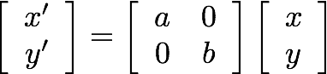
scale
matrix representation of scaling:
scaling matrix S
Scale

Slide 10
Shear
How?
Shear

Slide 11
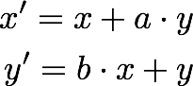
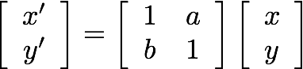
Shear
or in matrix form:
Shear

Slide 12
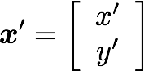
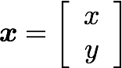



Rotation
How?
rotation around the origin
$$r$$
$$r$$
$$φ$$

Slide 13
Rotation
Polar coordinates…
x = r cos (φ)
y = r sin (φ)
x’ = r cos (φ + θ)
y’ = r sin (φ + θ)
Trigonometric Identity…
x’ = r cos(φ) cos(θ) – r sin(φ) sin(θ)
y’ = r sin(φ) cos(θ) + r cos(φ) sin(θ)
Substitute…
x’ = x cos(θ) - y sin(θ)
y’ = x sin(θ) + y cos(θ)
rotation around the origin
$$r$$
$$r$$
$$φ$$

Slide 14
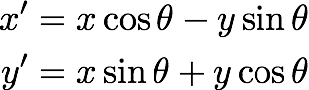
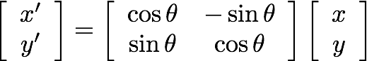
Rotation
or in matrix form:
rotation around the origin

Slide 15
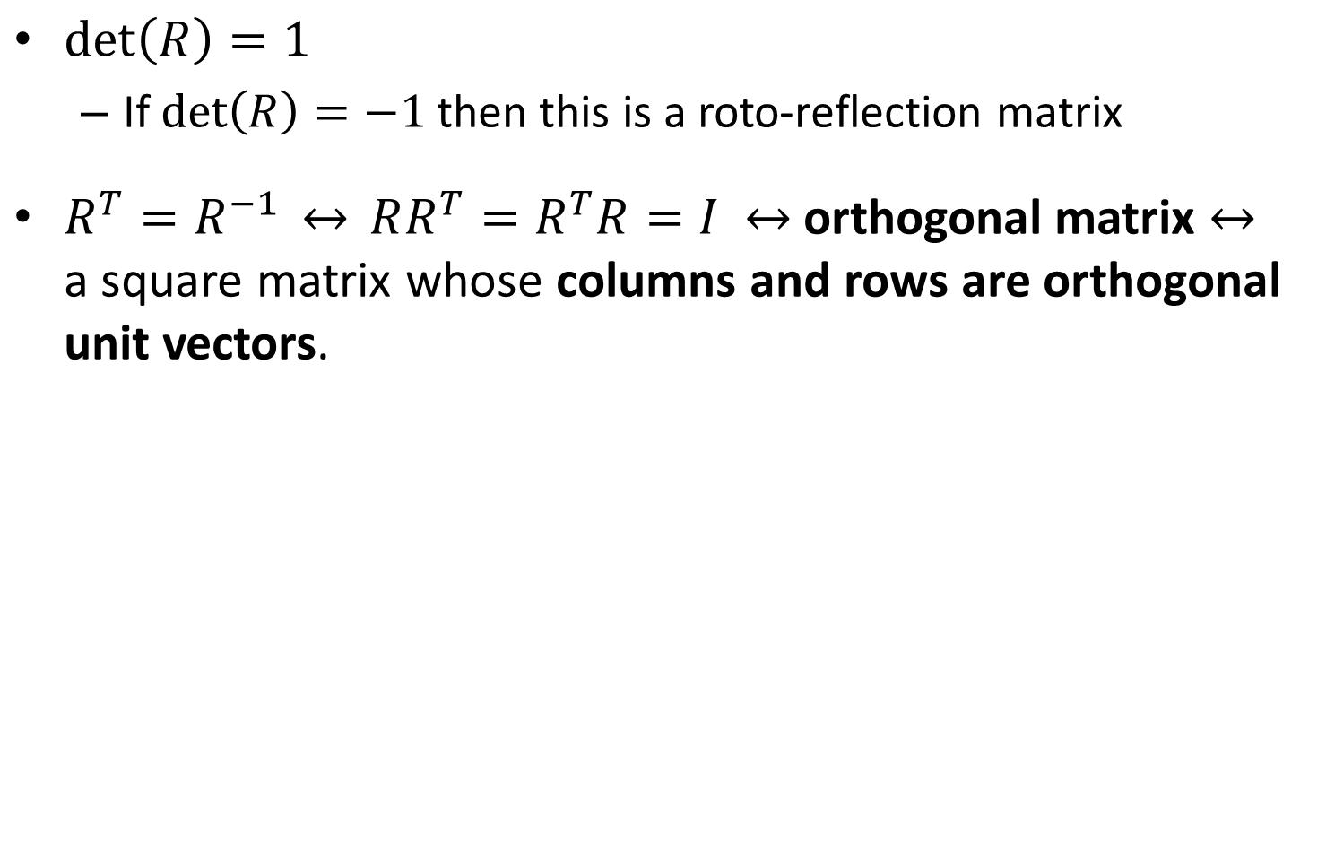
Important rotation matrix features
$\det\left(R\right)=1$
If $\det\left(R\right)=−1$ then this is a roto-reflection matrix
$R^{T}=R^{−1} \underset{↔}{} RR^{T}=R^{T}R=I$ orthogonal matrix a square matrix whose columns and rows are orthogonal unit vectors.

Slide 16
Concatenation
How do we do concatenation of two or more transformations?
Notes:
\\
\begin{bmatrix}x'
\\ y'
\end{bmatrix}
=
\begin{bmatrix}a & 0
\\ 0 & b
\end{bmatrix}
\begin{bmatrix}x
\\ y
\end{bmatrix}
\textrm{and then}
\begin{bmatrix}x''
\\ y''
\end{bmatrix}
=
\begin{bmatrix}cos\theta & -sin\theta
\\ sin\theta & cos\theta
\end{bmatrix}
\begin{bmatrix}x'
\\ y'
\end{bmatrix}
\\
\\
\mapsto
\\
\\
\begin{bmatrix}x''
\\ y''
\end{bmatrix}
=
\begin{bmatrix}cos\theta & -sin\theta
\\ sin\theta & cos\theta
\end{bmatrix}
\begin{bmatrix}a & 0
\\ 0 & b
\end{bmatrix}
\begin{bmatrix}x
\\ y
\end{bmatrix}
=
\begin{bmatrix}acos\theta & -sin\theta
\\ sin\theta & bcos\theta
\end{bmatrix}
\begin{bmatrix}x
\\ y
\end{bmatrix}

Slide 17
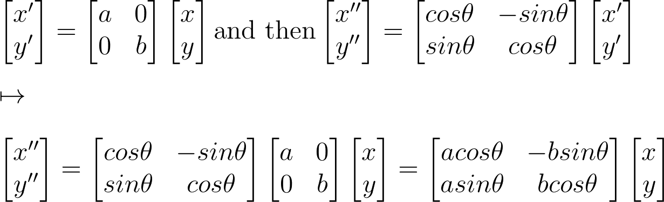
Concatenation
How do we do concatenation of two or more transformations?
Easy with matrix multiplication!
Notes:
\\
\begin{bmatrix}x'
\\ y'
\end{bmatrix}
=
\begin{bmatrix}a & 0
\\ 0 & b
\end{bmatrix}
\begin{bmatrix}x
\\ y
\end{bmatrix}
\textrm{and then}
\begin{bmatrix}x''
\\ y''
\end{bmatrix}
=
\begin{bmatrix}cos\theta & -sin\theta
\\ sin\theta & cos\theta
\end{bmatrix}
\begin{bmatrix}x'
\\ y'
\end{bmatrix}
\\
\\
\mapsto
\\
\\
\begin{bmatrix}x''
\\ y''
\end{bmatrix}
=
\begin{bmatrix}cos\theta & -sin\theta
\\ sin\theta & cos\theta
\end{bmatrix}
\begin{bmatrix}a & 0
\\ 0 & b
\end{bmatrix}
\begin{bmatrix}x
\\ y
\end{bmatrix}
=
\begin{bmatrix}acos\theta & -bsin\theta
\\ asin\theta & bcos\theta
\end{bmatrix}
\begin{bmatrix}x
\\ y
\end{bmatrix}

Slide 18
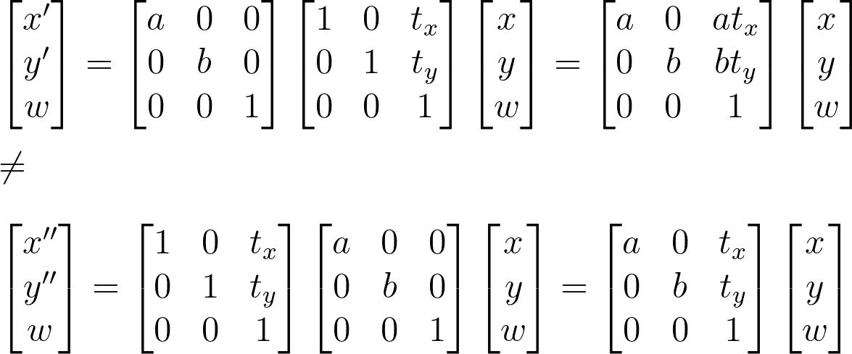
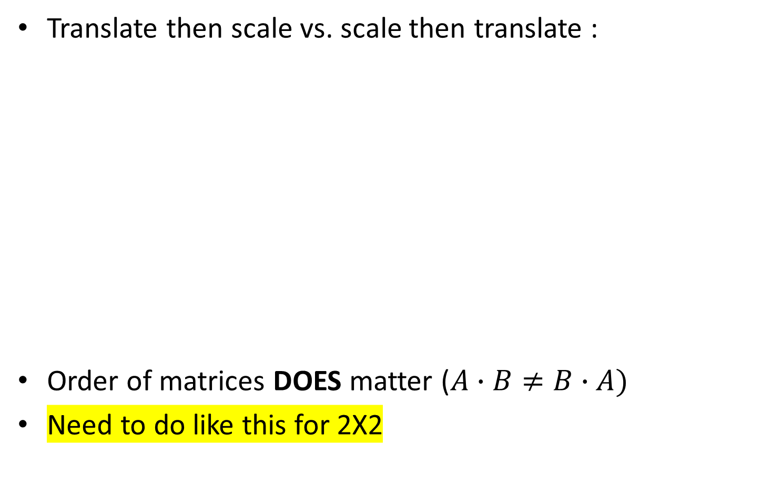
Affine transformation: example
Translate then scale vs. scale then translate :
Order of matrices DOES matter ($A∙B≠B∙A)$
Need to do like this for 2X2
Notes:
\\
\begin{bmatrix}x'
\\ y'
\\w
\end{bmatrix}
=
\begin{bmatrix}a & 0&0
\\ 0 & b&0
\\0&0&1
\end{bmatrix}
\begin{bmatrix}1 & 0&t_x
\\ 0 & 1&t_y
\\0&0&1
\end{bmatrix}
\begin{bmatrix}x
\\ y
\\w
\end{bmatrix}
=
\begin{bmatrix}a & 0 &at_x
\\ 0 & b & bt_y
\\0&0&1
\end{bmatrix}
\begin{bmatrix}x
\\ y
\\w
\end{bmatrix}
\\\\
\neq
\\\\
\begin{bmatrix}x''
\\ y''
\\w
\end{bmatrix}
=
\begin{bmatrix}1 & 0&t_x
\\ 0 & 1&t_y
\\0&0&1
\end{bmatrix}
\begin{bmatrix}a & 0&0
\\ 0 & b&0
\\0&0&1
\end{bmatrix}
\begin{bmatrix}x
\\ y
\\w
\end{bmatrix}
=
\begin{bmatrix}a & 0 &t_x
\\ 0 & b & t_y
\\0&0&1
\end{bmatrix}
\begin{bmatrix}x
\\ y
\\w
\end{bmatrix}

Slide 19
Translation
How?

Slide 20
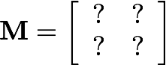
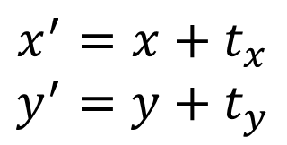
Translation
$$x^{′}=x+t_{x}$$
$$y^{′}=y+t_{y}$$
What about matrix representation?

Slide 21
Translation
$$x^{′}=x+t_{x}$$
$$y^{′}=y+t_{y}$$
What about matrix representation?
Not possible.

Slide 22
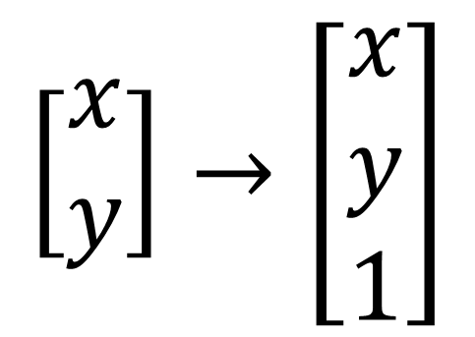
Homogeneous coordinates
Homogeneous coordinates represent 2D point with a 3D vector.
heterogeneous coordinates
homogeneous coordinates
$$\left[\begin{matrix}x \\ y\end{matrix}\right]→\left[\begin{matrix}x \\ y \\ 1\end{matrix}\right]$$

Slide 23
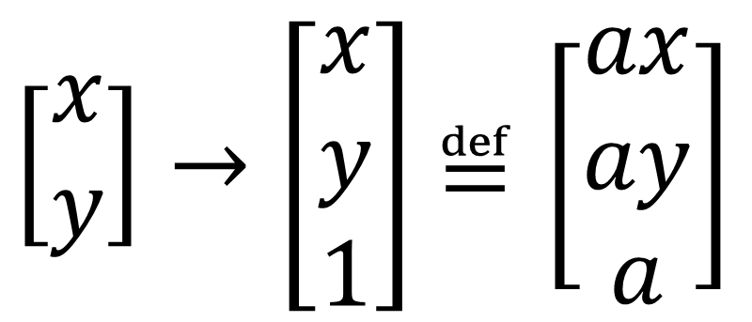
Homogeneous coordinates
Homogeneous coordinates represent 2D point with a 3D vector:
Homogeneous coordinates are only defined up to scale.
heterogeneous coordinates
homogeneous coordinates
$\left[\begin{matrix}x \\ y\end{matrix}\right]→\left[\begin{matrix}x \\ y \\ 1\end{matrix}\right]$ $≝\left[\begin{matrix}ax \\ ay \\ a\end{matrix}\right]$

Slide 24
Translation
How do we do it now?
$$x^{′}=x+t_{x}$$
$$y^{′}=y+t_{y}$$

Slide 25
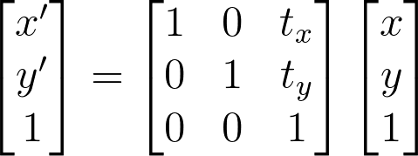
Translation
$$x^{′}=x+t_{x}$$
$$y^{′}=y+t_{y}$$
Notes:
\\
\begin{bmatrix}x'
\\ y'
\\1
\end{bmatrix}
=
\begin{bmatrix}1 & 0 & t_x
\\ 0 & 1 & t_y
\\ 0 & 0 & 1
\end{bmatrix}
\begin{bmatrix}x
\\ y
\\1
\end{bmatrix}

Slide 26
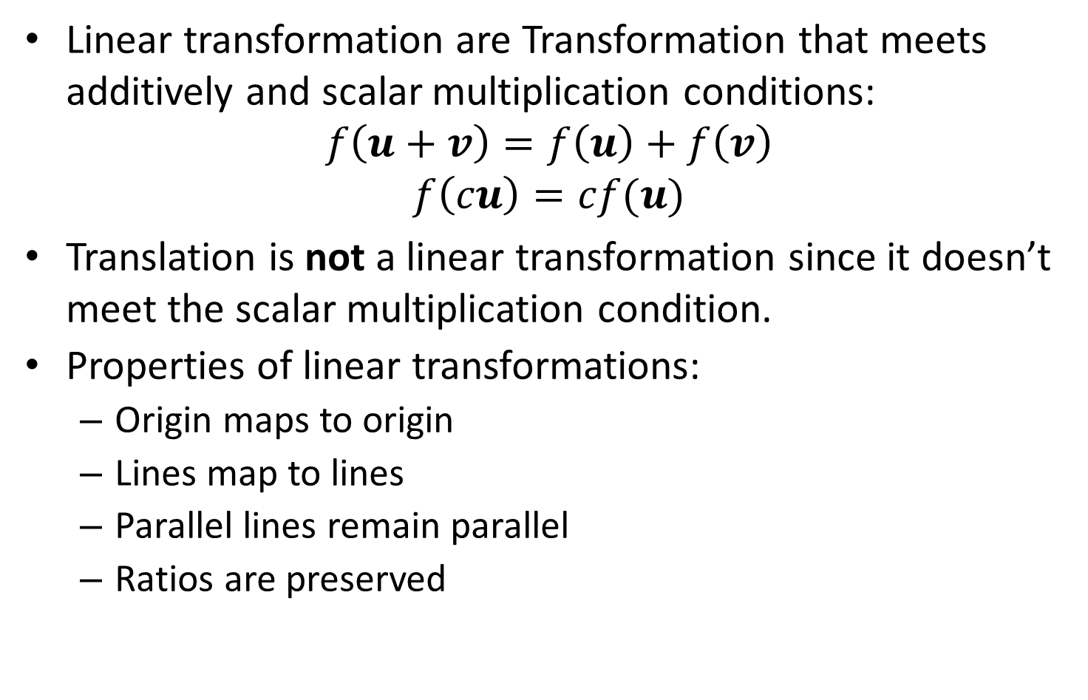
Side note: linear transformation
Linear transformation are Transformation that meets additively and scalar multiplication conditions:
$$f\left(u+v\right)=f\left(u\right)+f\left(v\right)$$
$$f\left(cu\right)=cf(u)$$
Translation is not a linear transformation since it doesn’t meet the scalar multiplication condition.
Properties of linear transformations:
Origin maps to origin
Lines map to lines
Parallel lines remain parallel
Ratios are preserved

Slide 27
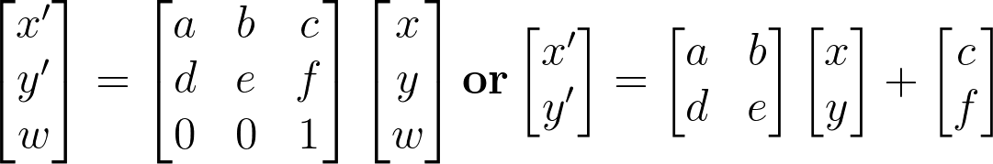
Affine Transformations
Affine transformations are combinations of linear transformations and translations
Properties of affine transformations:
Origin maps to origin
Lines map to lines
Parallel lines remain parallel
Ratios are preserved
Notes:
\\
\begin{bmatrix}x'
\\ y'
\\w
\end{bmatrix}
=
\begin{bmatrix}a & b&c
\\ d & e&f
\\0&0&1
\end{bmatrix}
\begin{bmatrix}x
\\ y
\\w
\end{bmatrix}
\mathrm{\mathbf{or}}
\begin{bmatrix}x'
\\ y'
\end{bmatrix}
=
\begin{bmatrix}a & b
\\ d & e
\end{bmatrix}
\begin{bmatrix}x
\\ y
\end{bmatrix}
+
\begin{bmatrix}c
\\ f
\end{bmatrix}

Slide 28
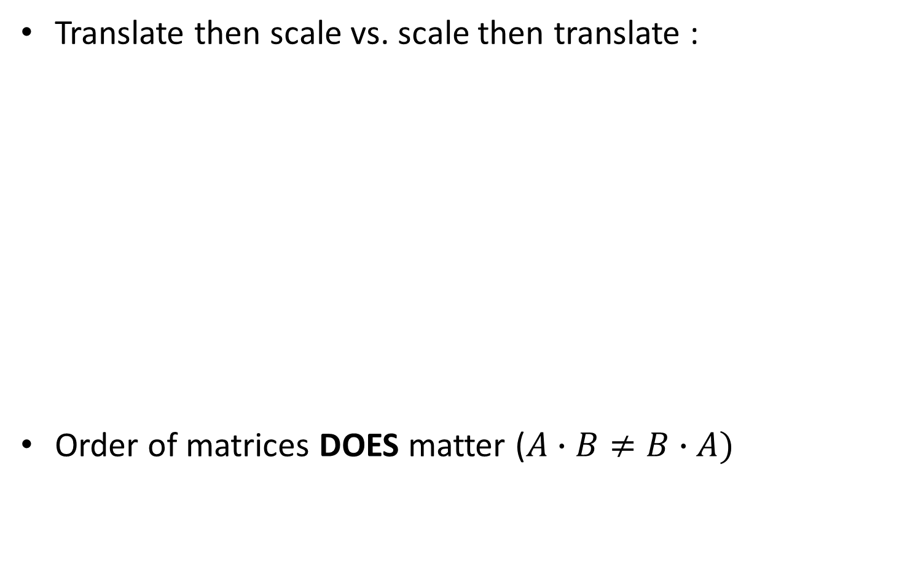
Affine transformation: example
Translate then scale vs. scale then translate :
Order of matrices DOES matter ($A∙B≠B∙A)$
Notes:
\\
\begin{bmatrix}x'
\\ y'
\\w
\end{bmatrix}
=
\begin{bmatrix}a & 0&0
\\ 0 & b&0
\\0&0&1
\end{bmatrix}
\begin{bmatrix}1 & 0&t_x
\\ 0 & 1&t_y
\\0&0&1
\end{bmatrix}
\begin{bmatrix}x
\\ y
\\w
\end{bmatrix}
=
\begin{bmatrix}a & 0 &at_x
\\ 0 & b & bt_y
\\0&0&1
\end{bmatrix}
\begin{bmatrix}x
\\ y
\\w
\end{bmatrix}
\\\\
\neq
\\\\
\begin{bmatrix}x''
\\ y''
\\w
\end{bmatrix}
=
\begin{bmatrix}1 & 0&t_x
\\ 0 & 1&t_y
\\0&0&1
\end{bmatrix}
\begin{bmatrix}a & 0&0
\\ 0 & b&0
\\0&0&1
\end{bmatrix}
\begin{bmatrix}x
\\ y
\\w
\end{bmatrix}
=
\begin{bmatrix}a & 0 &t_x
\\ 0 & b & t_y
\\0&0&1
\end{bmatrix}
\begin{bmatrix}x
\\ y
\\w
\end{bmatrix}

Slide 29
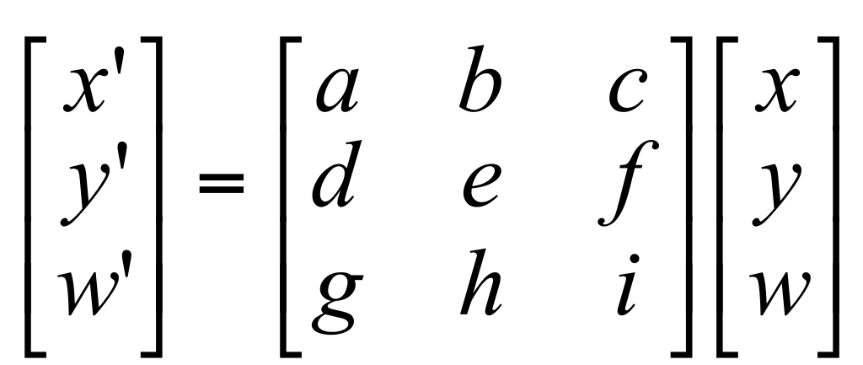
Projective transformation
Also known as homography or homographic transformation.
A generalization of affine transformation.
Properties of projective transformations:
Origin maps to origin
Lines map to lines
Parallel lines remain parallel
Ratios are preserved

Slide 30
Projective transformation
How many DOFs do we have here?

Slide 31
Projective transformation
How many DOFs do we have here?
8, since it is true up to scale (homogenous coordinates)

Slide 32
contents
2D->2D transformations
3D->3D transformations
3D->2D transformations (3D projections)
Perspective projection
Orthographic projection

Slide 33
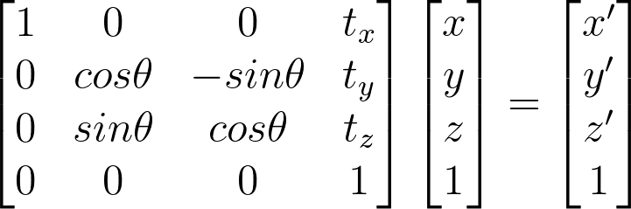
3D->3D transformations
Exactly the same as 2D->2D transformations from earlier, just with 3D.
What do we see here?
Notes:
\begin{bmatrix}1&0&0&t_x
\\0&cos\theta & -sin\theta&t_y
\\0& sin\theta & cos\theta&t_z
\\0&0&0&1
\end{bmatrix}
\begin{bmatrix}x
\\ y
\\z
\\1
\end{bmatrix}
=
\begin{bmatrix}
x'
\\y'
\\z'
\\1
\end{bmatrix}

Slide 34
3D->3D transformations
Exactly the same as 2D->2D transformations from earlier, just with 3D.
What do we see here?
Rotation around x axis and then translation
Notes:
\begin{bmatrix}1&0&0&t_x
\\0&cos\theta & -sin\theta&t_y
\\0& sin\theta & cos\theta&t_z
\\0&0&0&1
\end{bmatrix}
\begin{bmatrix}x
\\ y
\\z
\\1
\end{bmatrix}
=
\begin{bmatrix}
x'
\\y'
\\z'
\\1
\end{bmatrix}

Slide 35
contents
2D->2D transformations
3D->3D transformations
3D->2D transformations (3D projections)
Perspective projection
Orthographic projection

Slide 36
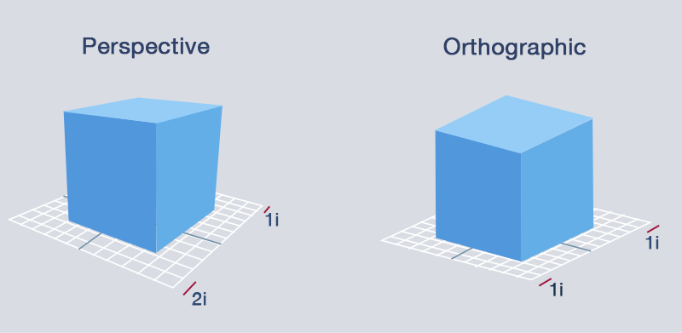
3D projection
3D projection is any method of mapping three-dimensional points to a two-dimensional plane.
Two types of projections are orthographic and perspective.

Slide 37
Perspective- definition
the art of drawing solid objects on a two-dimensional surface so as to give the right impression of their height, width, depth, and position in relation to each other when viewed from a particular point.
a particular attitude toward or way of regarding something; a point of view.

Slide 38
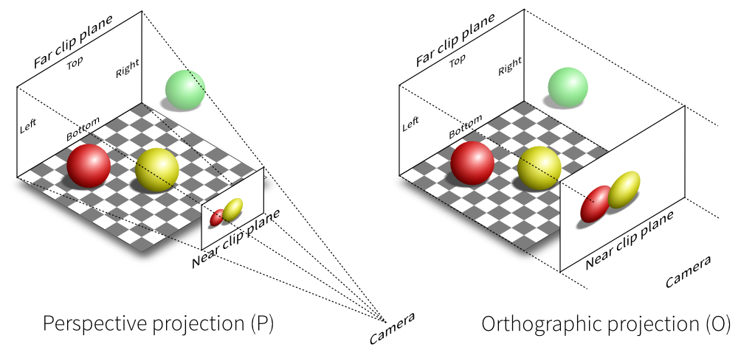
Perspective projection
Perspective projection is the kind of projection we get from a regular image of a regular (pinhole) camera.

Slide 39


perspective manipulation

Slide 40
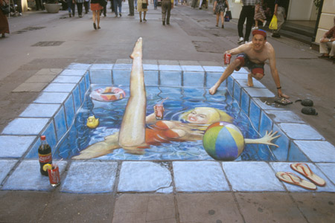
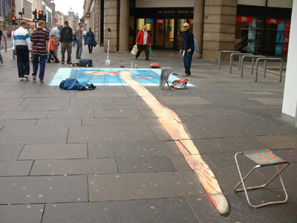
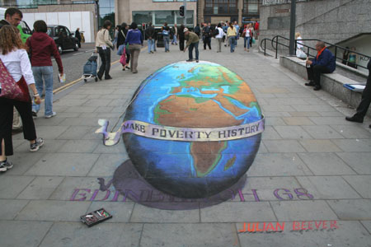
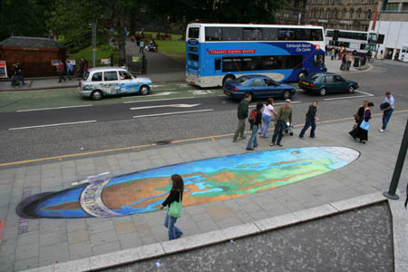
Street art- perspective manipulation

Slide 41
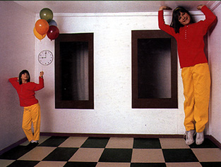
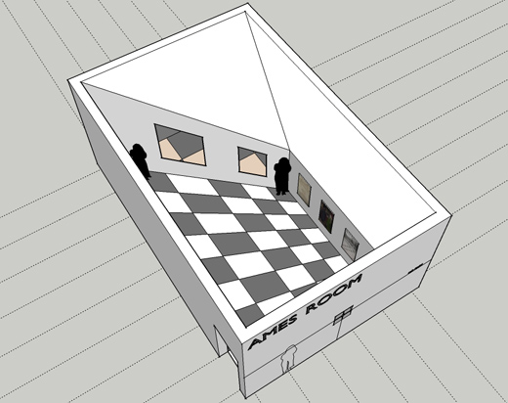
perspective manipulation- Ames Room

Slide 42
Image plane
When dealing with imaged 3D scenes, we tend to use the image plane rather than the sensor plane which is flipped.
real-world object
image plane
sensor plane
focal
length f
focal
length f

Slide 43


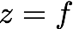
Perspective projection
Perspective projection (also known as perspective transformation) is a linear projection where three dimensional objects are projected on the image plane.
image plane
camera center
principal axis
Notes:
\begin{bmatrix}x
\\ y
\\ z
\end{bmatrix}
\begin{bmatrix}u
\\ v
\end{bmatrix}

Slide 44
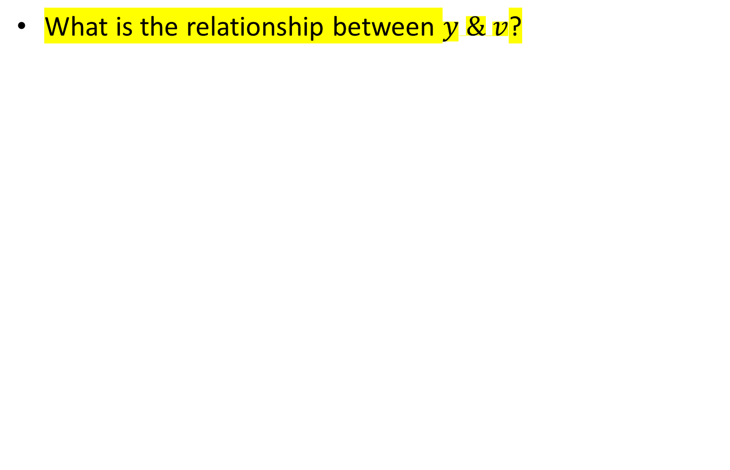
Perspective projection
What is the relationship between $y \& v$?
image plane

Slide 45
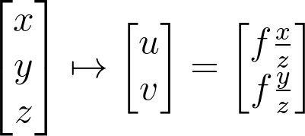
Perspective projection
Using triangle proportions (Thales’ theorem) we can easily conclude that:
image plane
Notes:
\begin{bmatrix}x
\\ y
\\ z
\end{bmatrix}
\mapsto
\begin{bmatrix}u
\\ v
\end{bmatrix}
=
\begin{bmatrix}f\frac{x}{z}
\\ f\frac{y}{z}
\end{bmatrix}

Slide 46
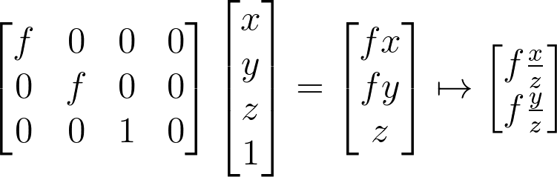
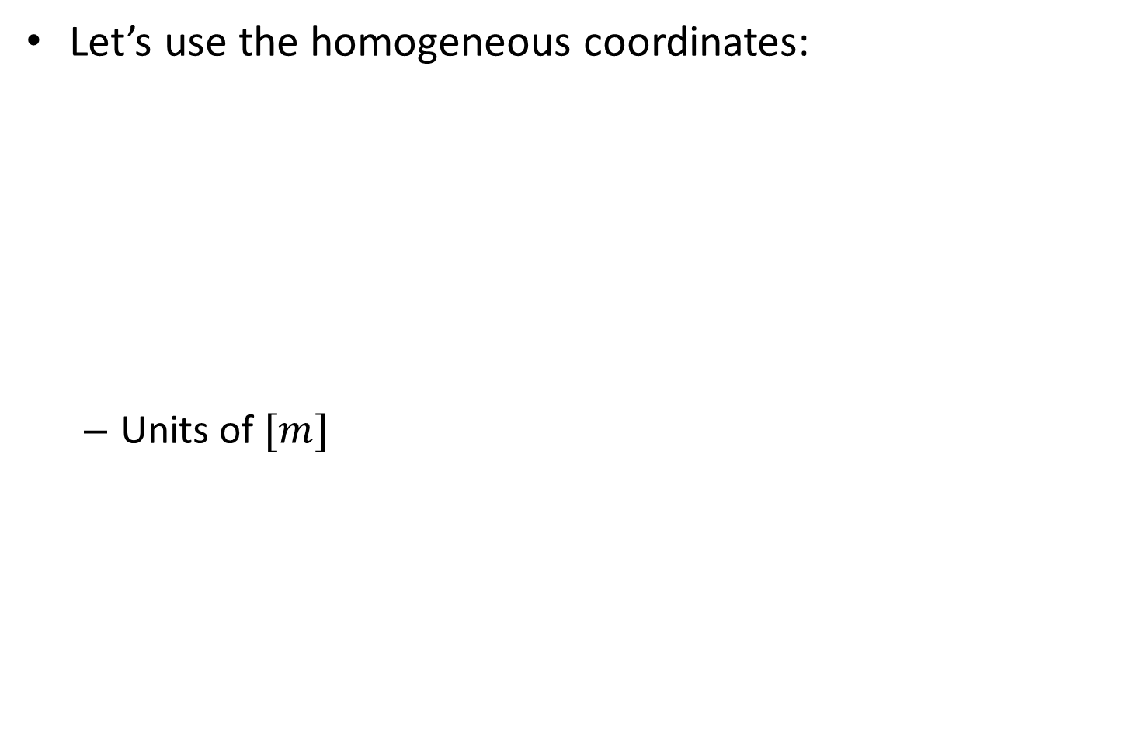
Perspective projection
Let’s use the homogeneous coordinates:
Units of $[m]$
Notes:
\begin{bmatrix}f & 0&0&0
\\ 0&f &0&0
\\0&0&1&0
\end{bmatrix}
\begin{bmatrix}x
\\ y
\\z
\\1
\end{bmatrix}
=
\begin{bmatrix}fx
\\ fy
\\z
\end{bmatrix}
\mapsto
\begin{bmatrix}f\frac{x}{z}
\\ f\frac{y}{z}
\end{bmatrix}

Slide 47
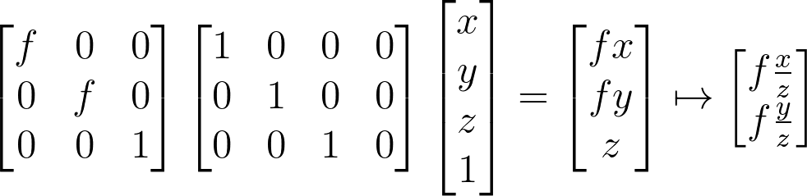
Perspective projection
Let’s split into 2 matrices and use 3D->2D homogenous coordinates:
Intrinsic camera matrix
Projection matrix
Notes:
\begin{bmatrix}f & 0&0
\\ 0&f &0
\\0&0&1
\end{bmatrix}
\begin{bmatrix}1 & 0&0&0
\\ 0&1 &0&0
\\0&0&1&0
\end{bmatrix}
\begin{bmatrix}x
\\ y
\\z
\\1
\end{bmatrix}
=
\begin{bmatrix}fx
\\ fy
\\z
\end{bmatrix}
\mapsto
\begin{bmatrix}f\frac{x}{z}
\\ f\frac{y}{z}
\end{bmatrix}

Slide 48
Vertigo effect
Has several different names (vertigo effect, dolly zoom, lens compression, perspective distortion) that all mean the same thing.
intro:
https://www.youtube.com/watch?v=UrhtKvBMZ3g (until 01:50)

Slide 49
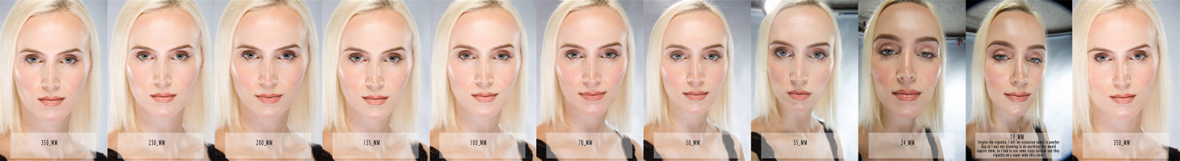
Vertigo effect
https://www.youtube.com/watch?v=_TTXY1Se0eg(until 02:55)

Slide 50
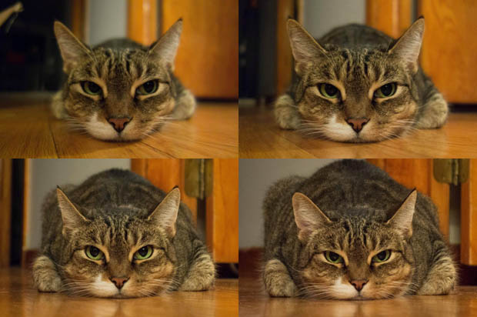
Vertigo effect

Slide 51
contents
2D->2D transformations
3D->3D transformations
3D->2D transformations (3D projections)
Perspective projection
Orthographic projection

Slide 52
Orthographic projection
A different kind of camera model that can be used is orthographic projection or orthographic camera.
This kind of projection is invariant to the distance from the camera, and only depends on the object’s size.

Slide 53
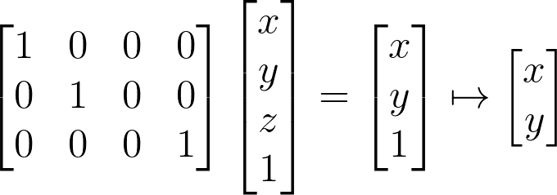
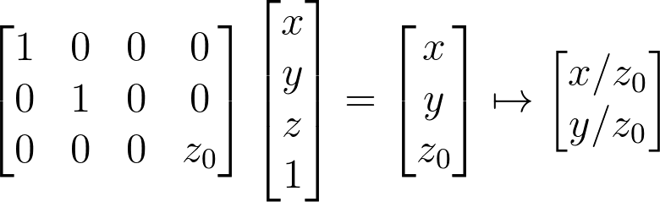
Orthographic projection
image
world
Orthographic matrix
Weak perspective matrix (with scale coefficient)
Notes:
\begin{bmatrix}1 & 0&0&0
\\ 0&1 &0&0
\\0&0&0&1
\end{bmatrix}
\begin{bmatrix}x
\\ y
\\z
\\1
\end{bmatrix}
=
\begin{bmatrix}x
\\ y
\\1
\end{bmatrix}
\mapsto
\begin{bmatrix}x
\\ y
\end{bmatrix}
=======================================
\begin{bmatrix}1 & 0&0&0
\\ 0&1 &0&0
\\0&0&0&z_0
\end{bmatrix}
\begin{bmatrix}x
\\ y
\\z
\\1
\end{bmatrix}
=
\begin{bmatrix}x
\\ y
\\z_0
\end{bmatrix}
\mapsto
\begin{bmatrix}x/z_0
\\ y/z_0
\end{bmatrix}

Slide 54
Orthographic projection
When can we assume a weak perspective camera?

Slide 55


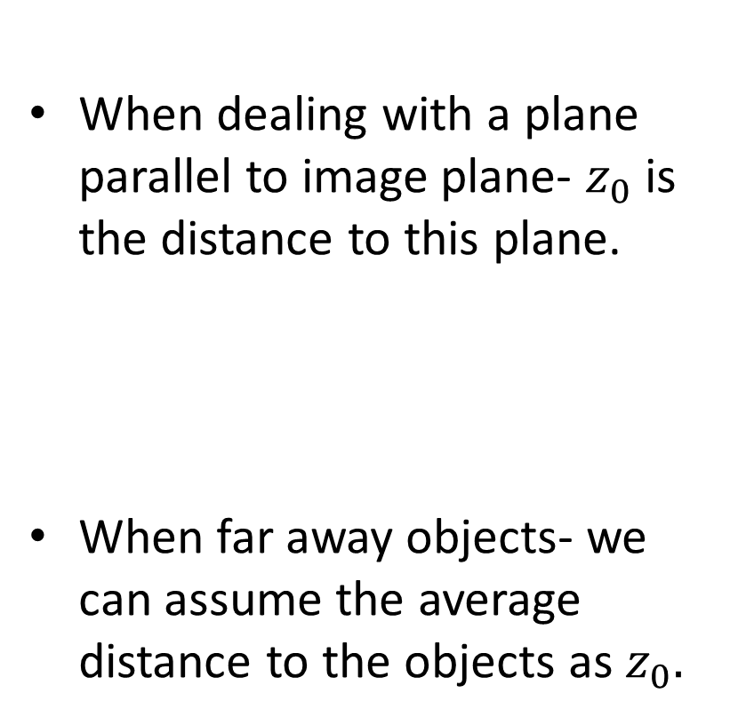
Orthographic projection
When can we assume a weak perspective camera?
When dealing with a plane parallel to image plane- $z_{0}$ is the distance to this plane.
When far away objects- we can assume the average distance to the objects as $z_{0}.$

Slide 56
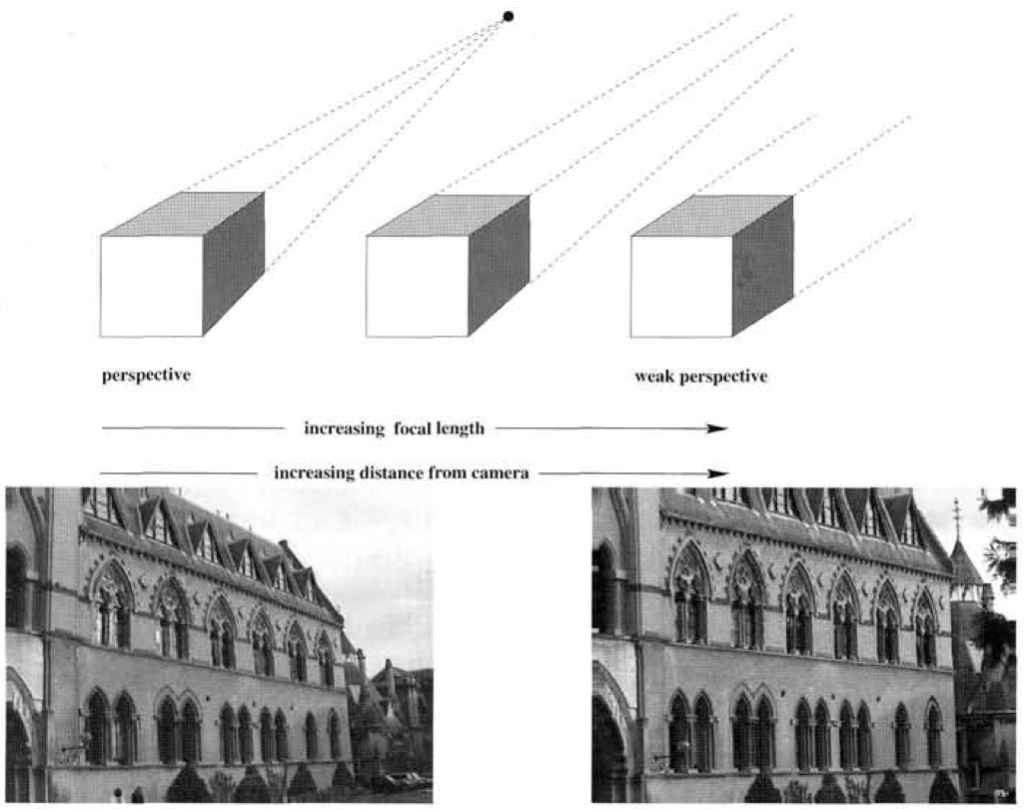
Weak perspective camera
One way to transform a regular perspective image to an orthographic view is simply taking the picture from a distance with zoom (large focal length).

Slide 57
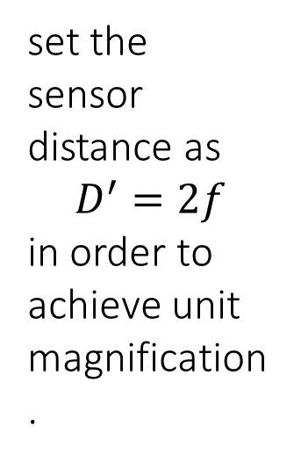
Weak perspective camera
Real orthographic camera:
Place a pinhole at focal length, so that only rays parallel to primary ray pass through.
set the sensor distance as
$$D^{′}=2f$$
in order to achieve unit magnification.
object distance D
focal length f
sensor distance D’

Slide 58
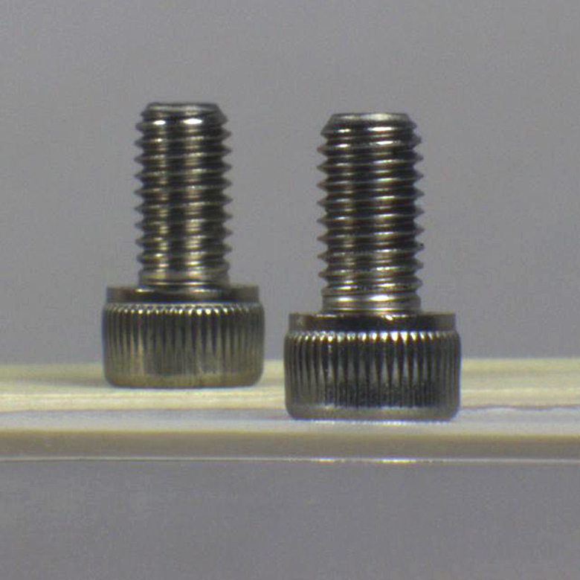
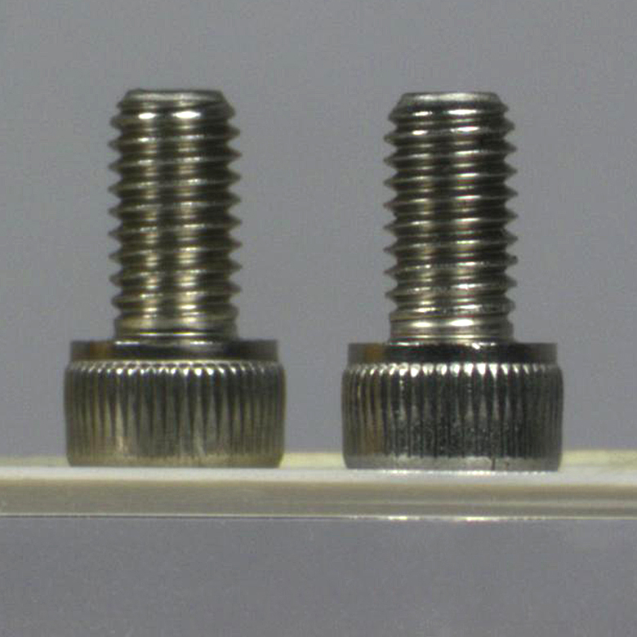
Weak perspective camera
perspective camera
weak perspective camera

Slide 59
Orthographic projection
Why we want to assume a weak perspective camera?

Slide 60
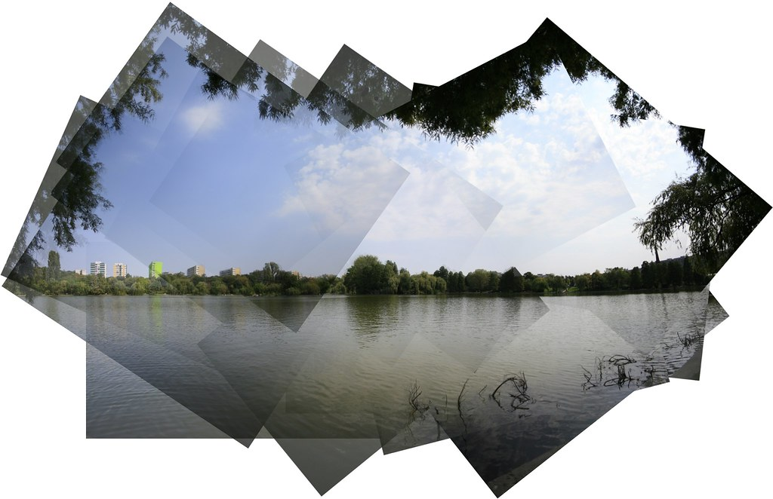
Orthographic projection
Why we want to assume a weak perspective camera?
Easier to do a lot of image manipulation. For example: image stitching (no projective transformation, just affine), called panograma.

